Slide 1
Integrating with APIs
Working with REST and JSON in PHP
Notes:
Anyone here done any API integrations?

Slide 2

Caitlin Bales
Community Engineer @ Microsoft
Working on tooling for APIs
Web enthusiast
Worked on API strategies from creation to consumption

Slide 3
Steps to Integration
Why APIs?
1
Calling APIs in PHP
3
Authenticating your App
4
Debugging Tools
5
RESTful Web Services
2

Slide 4
1 The API Ecosystem

Slide 5
API Industry
Businesses are realizing an API strategy brings them more:
Developer integration
Platform stickiness
Development speed
Some shops are becoming API-first
Reduces friction in cross-collaboration across teams
Increases dogfooding
Avoids technical debt
Notes:
REST is a pattern/protocol that everyone uses

Slide 6
Why use APIs?
Don’t reinvent the wheel
Spend time building business-differentiated software
Increase your data scope
Faster and cheaper than purchasing off-the-shelf solutions

Slide 7
2 RESTful Web Services

Slide 8
REST
Stands for Representational State Transfer
Message based pattern for developing web services
Centered around resources
Provides a common transactional model for data transfer
Lightweight alternative to SOAP

Slide 9
JSON Data
JavaScript Object Notation
Centers around key-value pairs
Looks to provide more readable format than XML
Sends less data
Easy to serialize/deserialize (in PHP, json_encode & json_decode)
Most popular formatting for REST call data

Slide 10
Request Recipe
VERB
+
HEADERS
+
URL
+
BODY
GET
POST
PUT PATCH DELETE
…
Accept
Authorization
Content-Length
Content-Type
Host
X-Requested-With
DNT
{
“fname”: “Bob”,
“lname”: “Barker”
}
https://api.site.com/v1/
http://bobsapi.com/users

Slide 11
3 Calling APIs in PHP

Slide 12
Tools for Calling APIs
cURL - libcurl
pecl_http - pecl
Guzzle – composer package

Slide 13
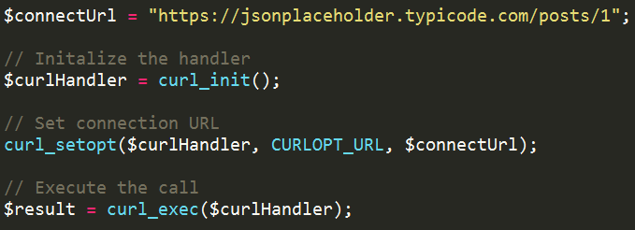
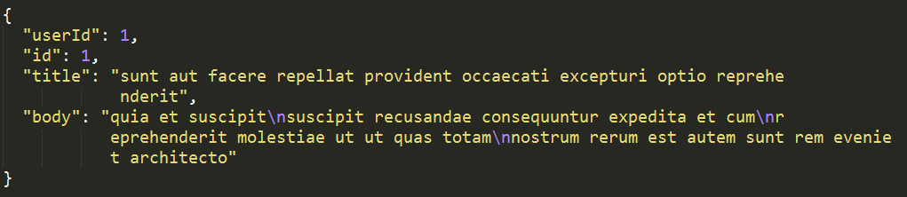
cURL - GET

Slide 14
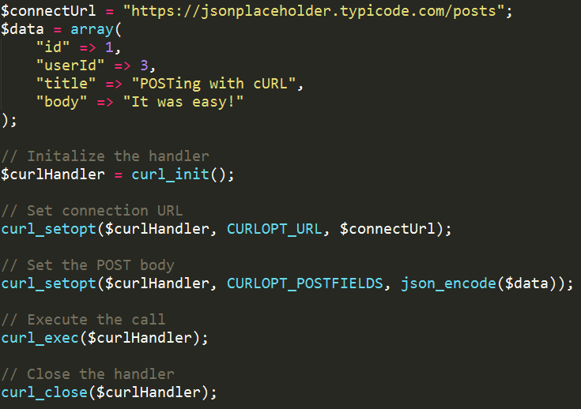
cURL - POST

Slide 15
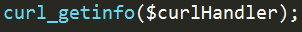
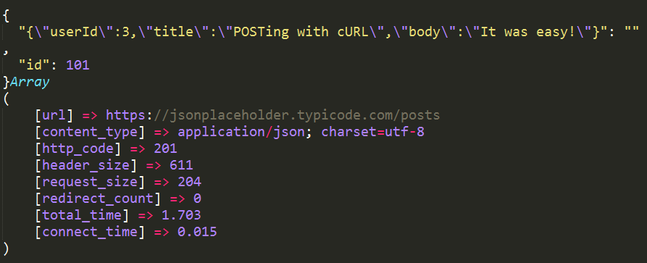
cURL - POST

Slide 16
Other Request Methods
What about PUT, PATCH, DELETE, or other REST methods?
Use CUSTOM_REQUEST
Not all APIs support all request methods – consult the docs

Slide 17
Guzzle
PHP HTTP client
Handles boilerplate request/response code
Object-oriented
Support for asynchronous calling
Option to use other handlers (i.e. React)
Mock handlers make it easy to test

Slide 18
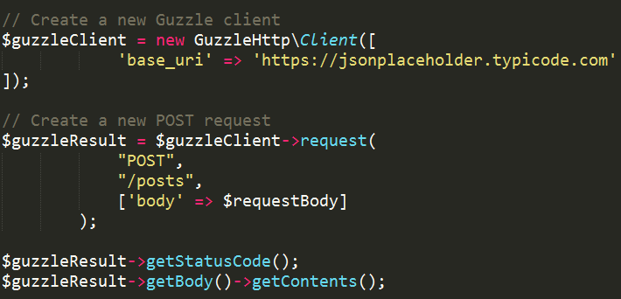
Guzzle

Slide 19
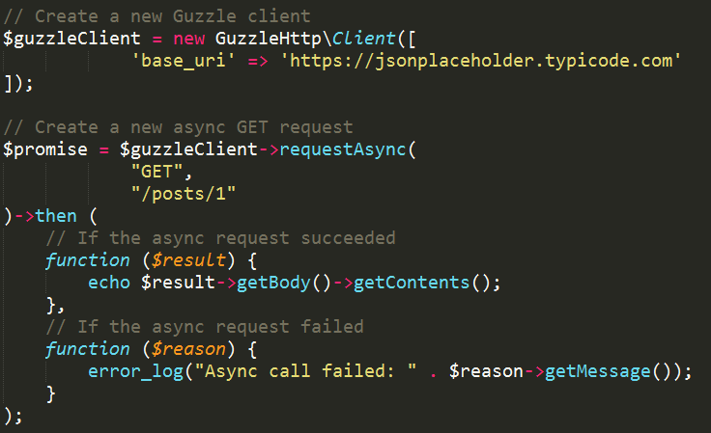
Guzzle - Async
Notes:
Has anyone done any async programming in PHP? Or just JavaScript?

Slide 20
OData
Best practices protocol for building and consuming REST APIs
Originally developed by Microsoft, accepted by OASIS
Works with JSON and Atom (XML)
Supports querying
$filter, $select
Navigation properties
Deltas – track changes
$metadata – XML representation of the objects, navigation paths, and properties available

Slide 21
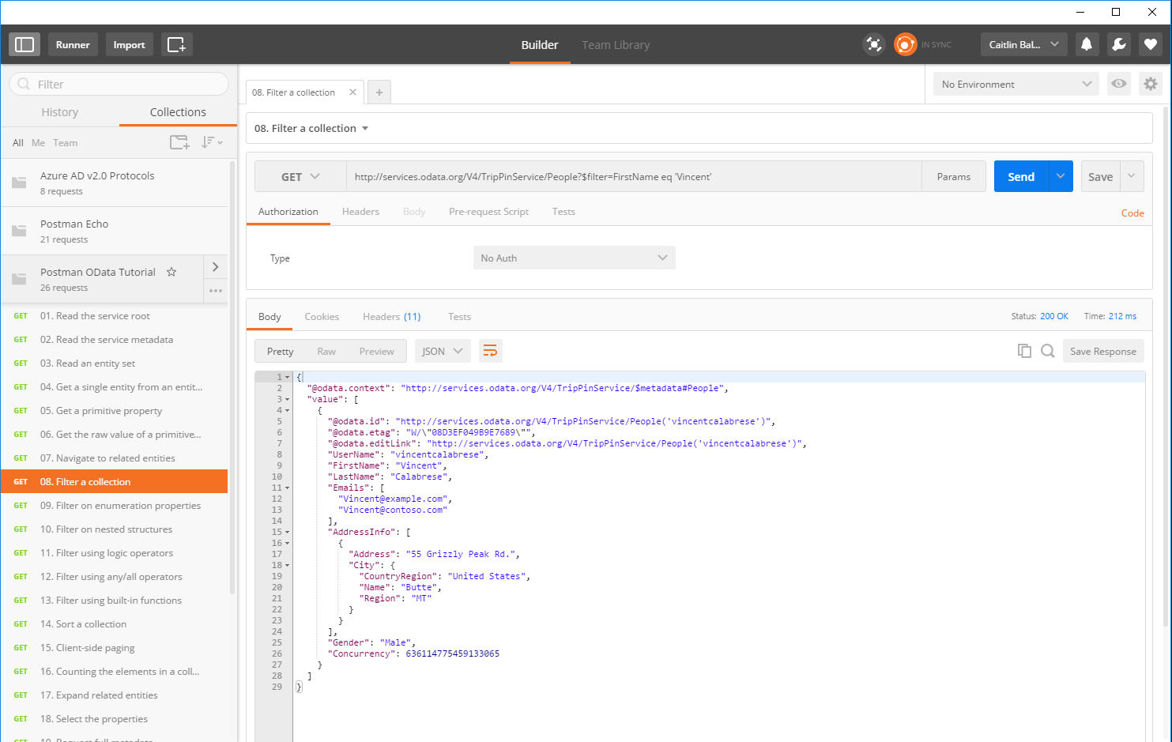

Slide 22
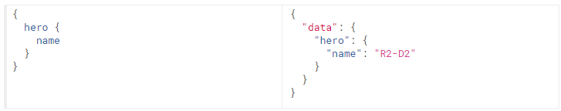
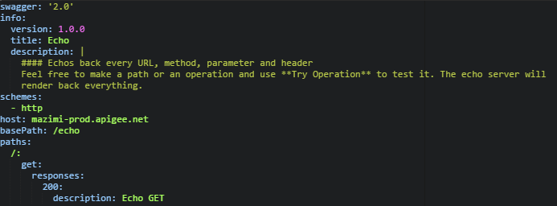
Other Tools
GraphQL
Created by Facebook in 2012
API query language
Built upon graph structured data
Swagger
Framework for APIs
Enables documentation and SDK generation
Goal of improving API discoverability

Slide 23
4 Authenticating your App

Slide 24
Authentication & Authorization
Proves that you are who you say you are
Allows you to access personal information
After authorizing, you receive a token which is then used to authenticate you
Proves to the service that you are allowed to access its resources
Allows you to access public information
Usually involves a public/private key pair

Slide 25

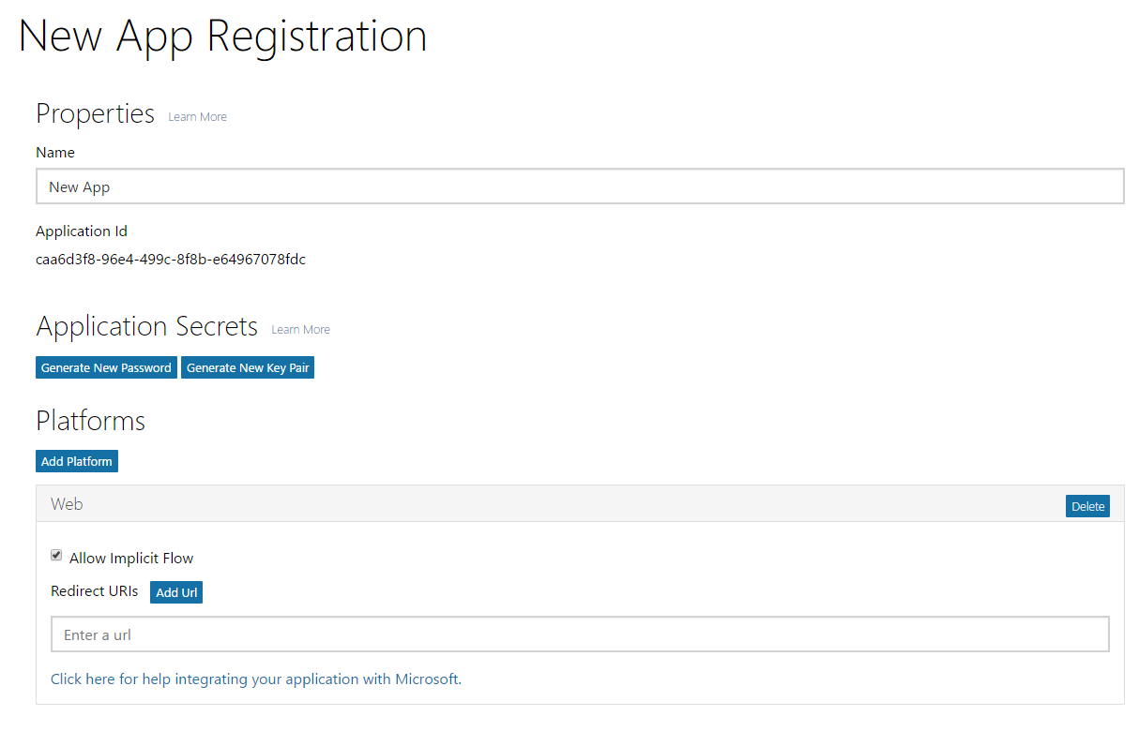
Setting up Authorization with an API
Most companies have you register an application with them on their site
You’ll get a public/private key pair
Callback URL sends you back into your application’s workflow

Slide 26
OAuth2 – Example Flow
The user is prompted to log in to API service to authenticate and then authorize the app to use their data
The server sends back an authorization code to the app
The app uses this code to ask for an access token
The server returns an access token to the client
Subsequent calls to the service use this access tokens
Notes:
Most services use OAuth or OAuth2 to authorize and authenticate applications

Slide 27
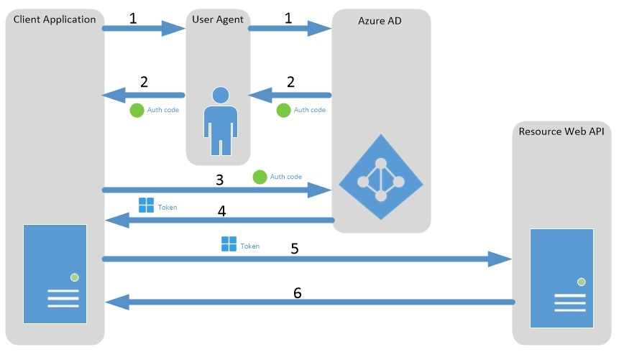
Notes:
The user is prompted to log in to API service to authenticate and then authorize the app to use their data
The server sends back an authorization code to the app
The app uses this code to ask for an access token
The server returns an access token to the client
Subsequent calls to the service use this access tokens

Slide 28
OAuth2
The application does not have access to your credentials and you are not passing credentials across the wire
In some implementations, tokens expire after a set amount of time
Using a refresh token, you can get a new valid access token

Slide 29
5 Debugging Tools

Slide 30

Postman
Started as a simple Chrome plugin for making HTTP requests
Allows you to test queries quickly without a shell application
Lots of other goodies
Collections
Test cases
Documentation
Sharing
Great for testing an API before deciding to integrate

Slide 31
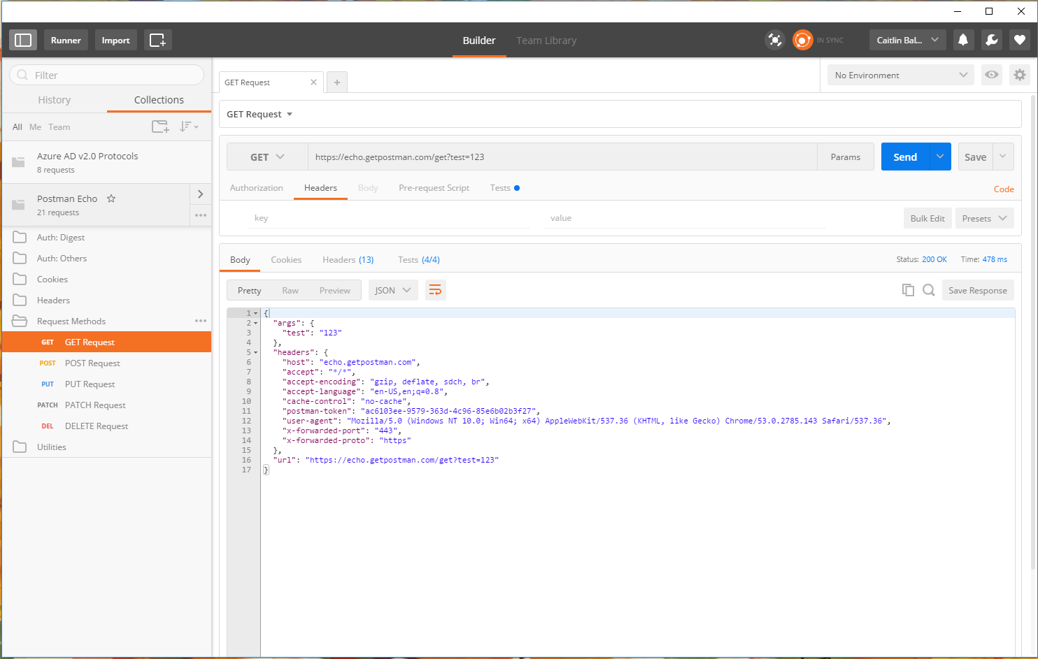
Notes:
Show PHP code download

Slide 32
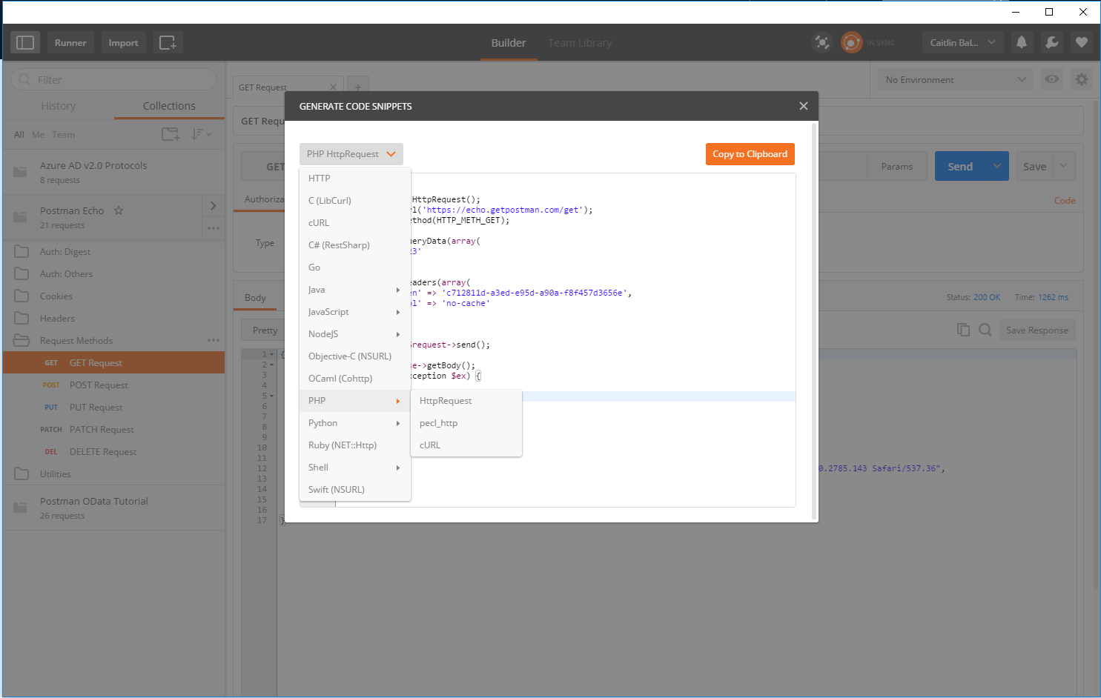

Slide 33


Fiddler / Charles Proxy
HTTP debugging proxy server
Captures data sent across the wire – Internet, Intranet, and native apps
Allows editing of requests for testing purposes
Intercept requests
Send requests

Slide 34
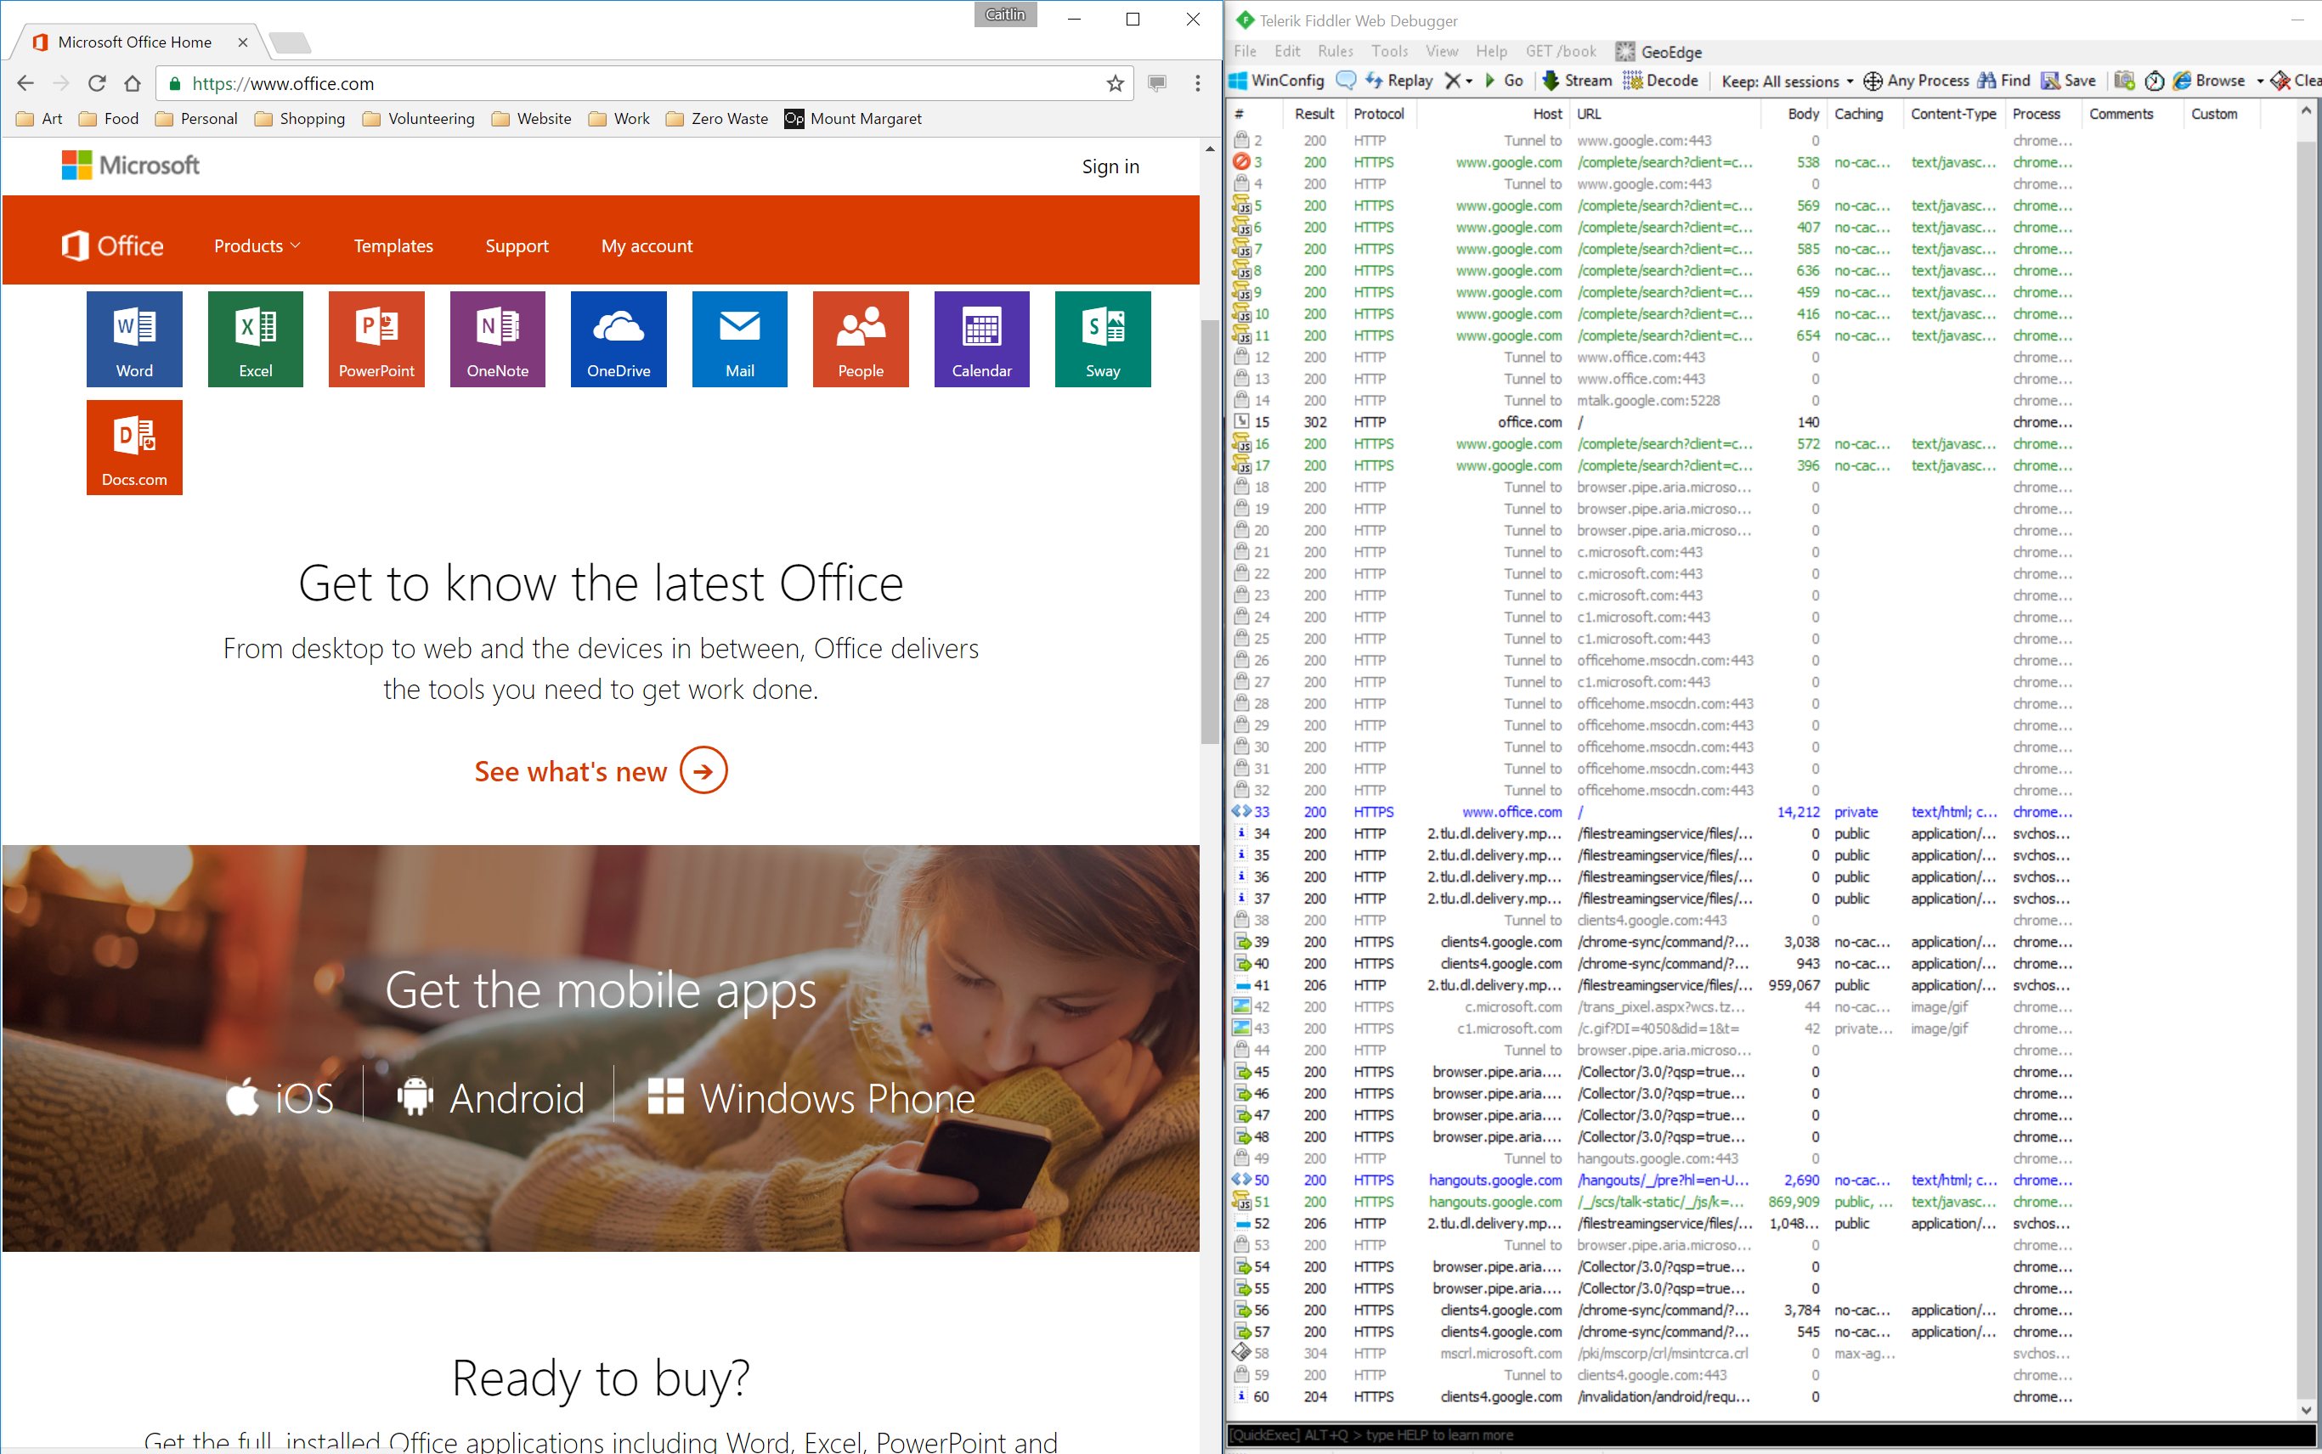

Slide 35
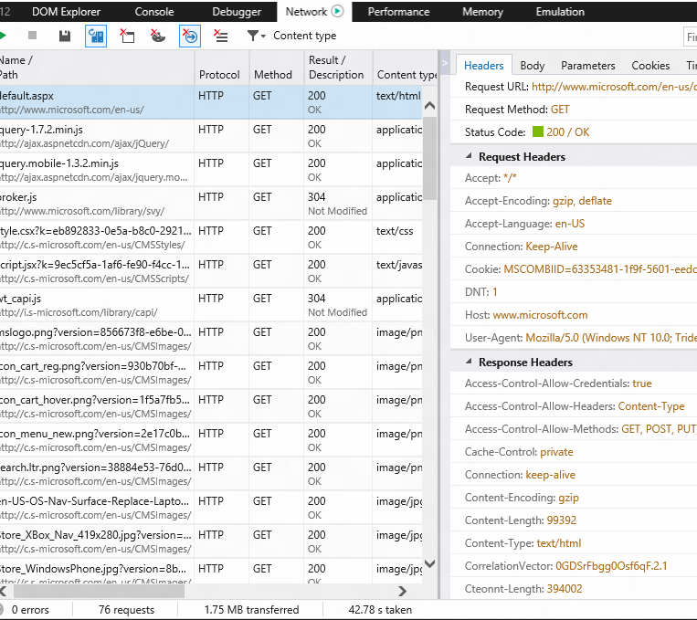
Modern Browser Tools
View requests and responses of web apps
Data is specific to the current web page
Support remote sessions
Good for tracing a page’s web traffic

Slide 36
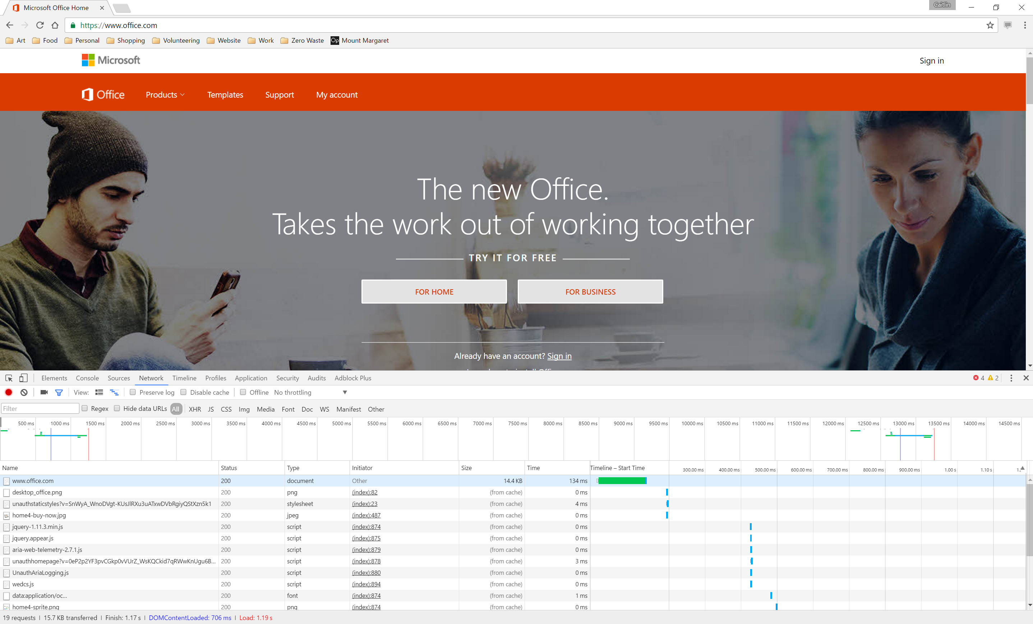

Slide 37
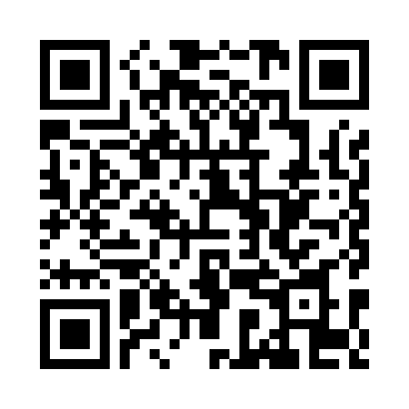
Resources
Slides & sample code – github.com/cbales
Programmable Web
Nordic APIs REST vs SOAP
Build a lightweight API with Slim
Feedback form

